Slide 1
What is JavaScript

Slide 2
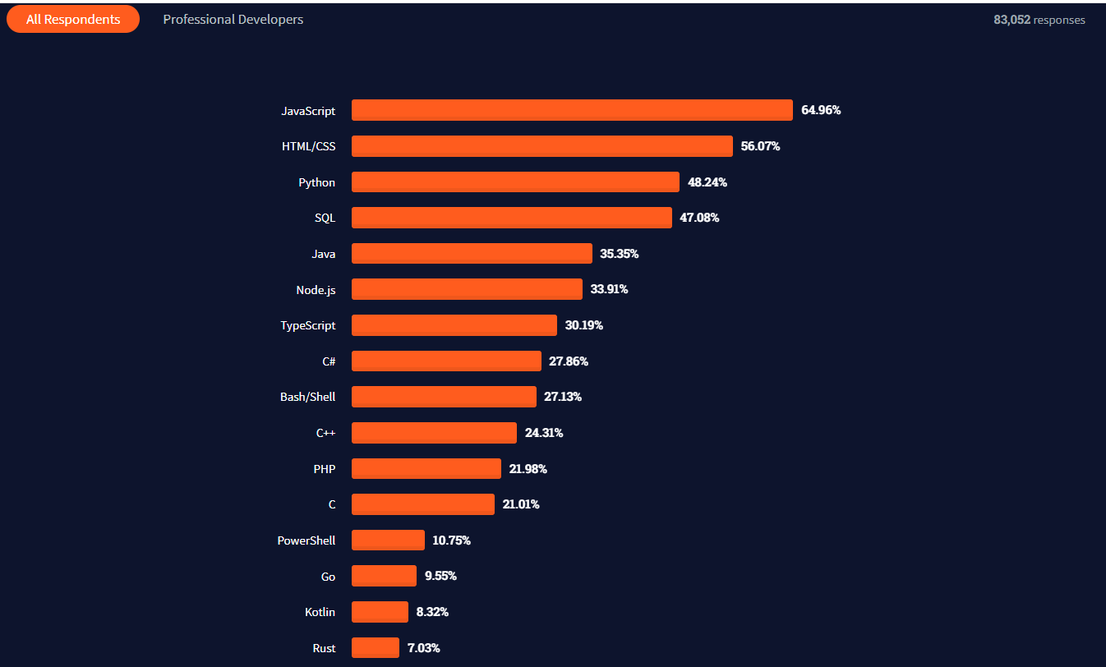
Most popular technologies
Click here

Slide 3
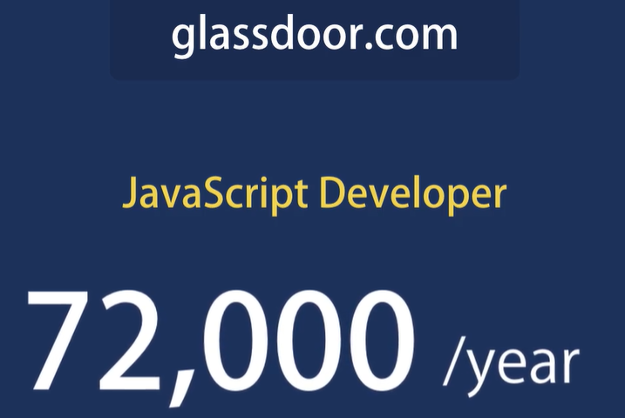
Average salary

Slide 4
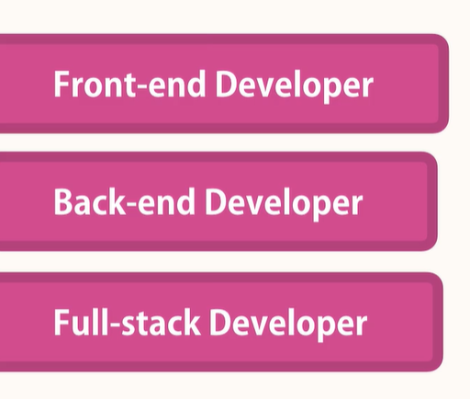
U can work

Slide 5
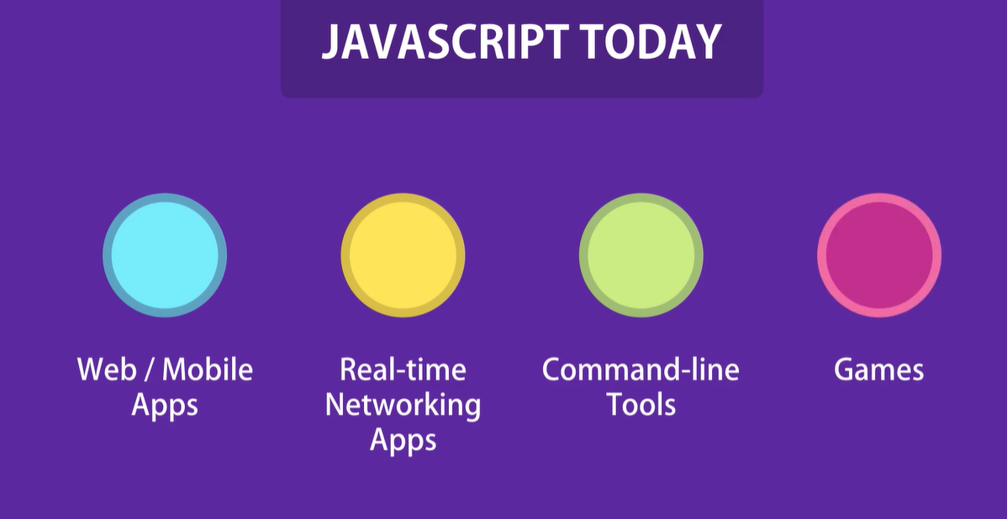
What u can do with JS

Slide 6
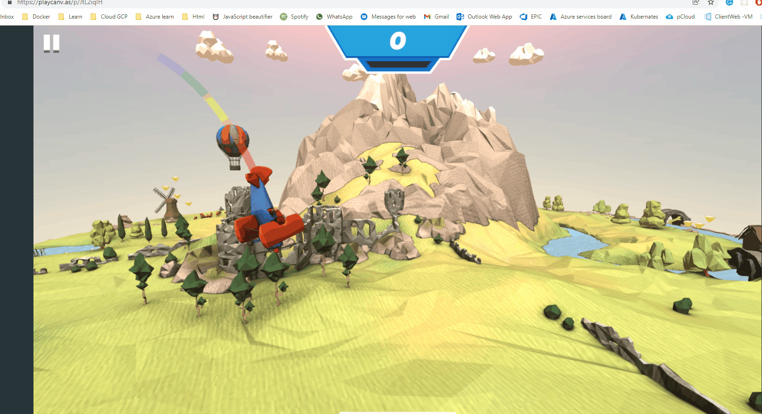

Slide 7
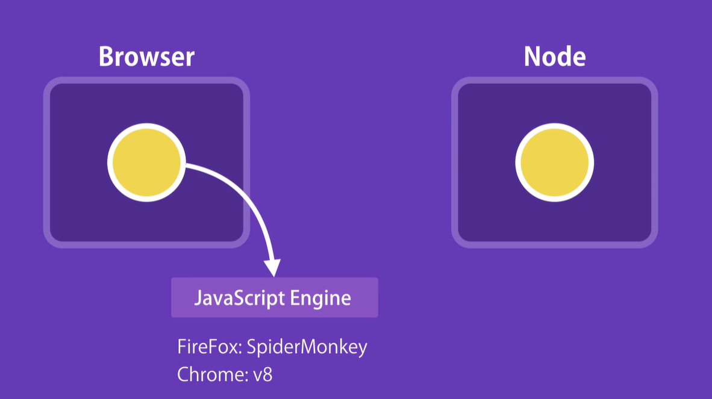
Where JavaScript Run ?
In 2009 Brain Doll took the open source Javascript engine in chrome and embedded it inside a C++ program. He called that program Node. And now we can run JavaScript code outside the browser inside the Node.

Slide 8
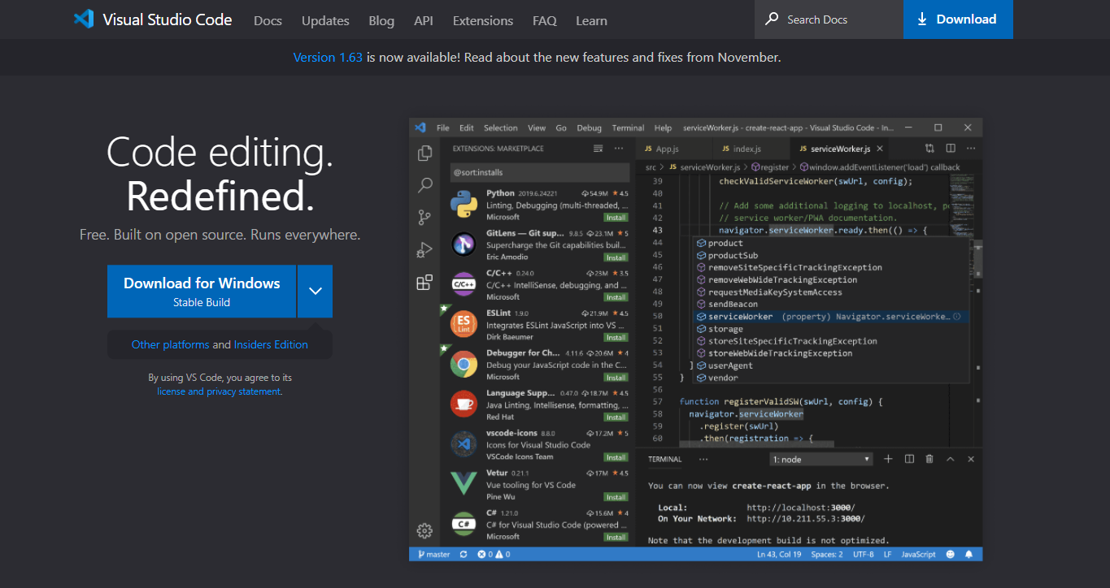
Download and Install

Slide 9
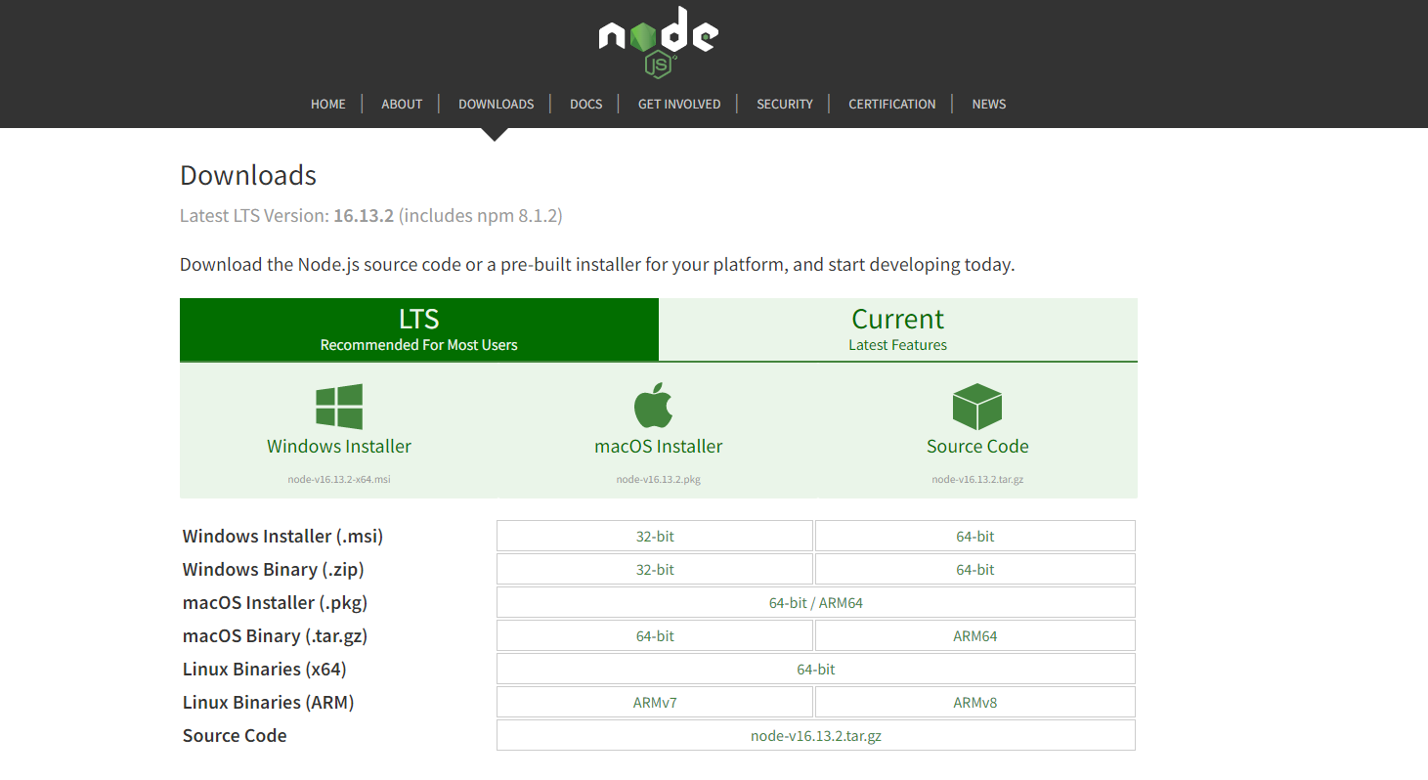
Download Nodejs

Slide 10
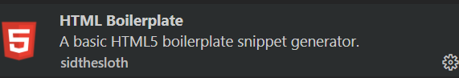
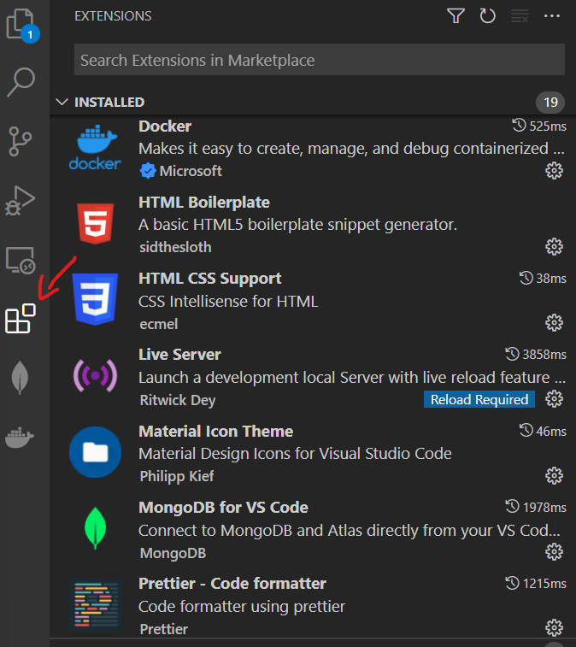
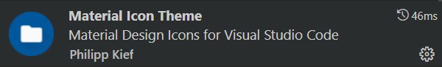
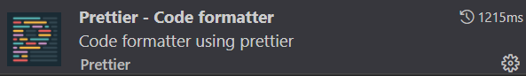
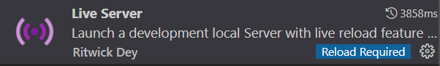
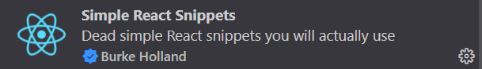
VS CODE Extensions

Slide 11
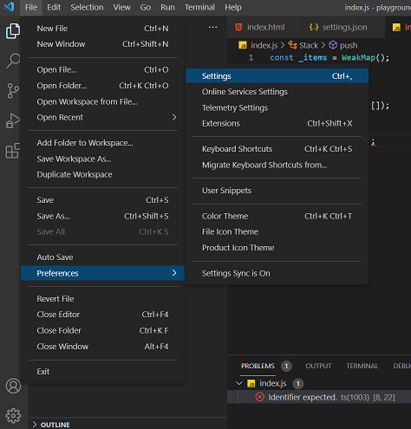
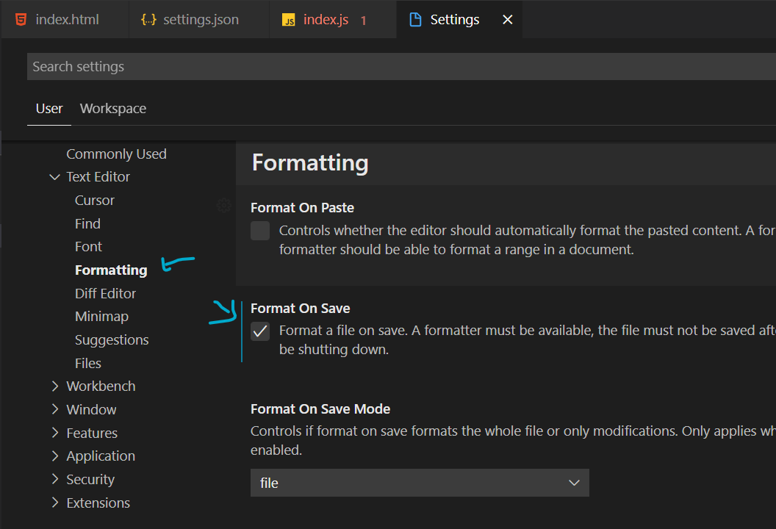

Slide 12
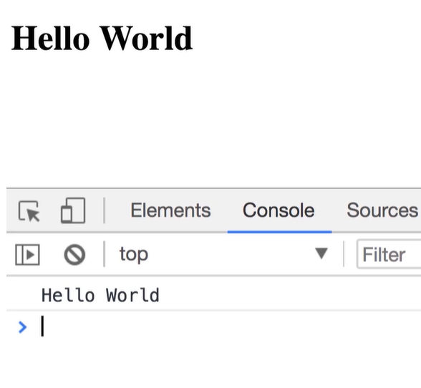
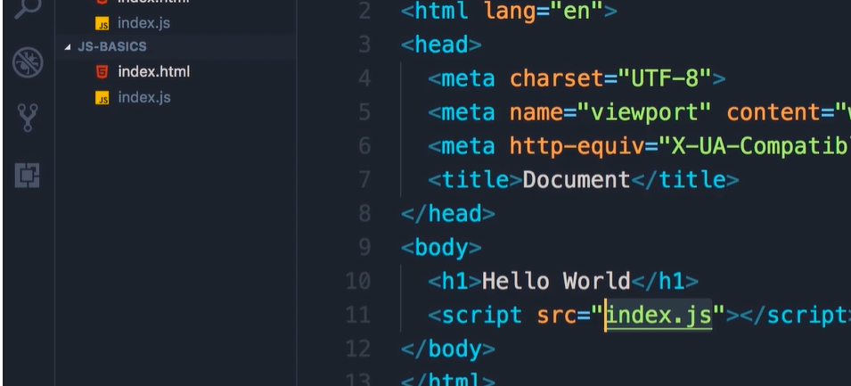
JavaScript In Browser and Separation of Concerns Code Time

Slide 13
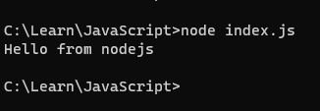
How to run JavaScript code in Node

Slide 14
Variables
We use a variable to store data temporarily.
Use let keyword to declare a variable.
By default, the value of the variables in JavaScript is undefined.
Roles of declaration variables.
Cannot be a reserved keyword (if, else, var, let ...).
Should be meaningful.
Cannot start with a number (1name).
Cannot contain a space or hyphen (-).
Convention of naming variables in JavaScript is camel case.
Variables are case-sensitive.
U can declare multiple variable at once.

Slide 15
Constants
The value of variable (let) can change but the value of (const) can’t be change.

Slide 16
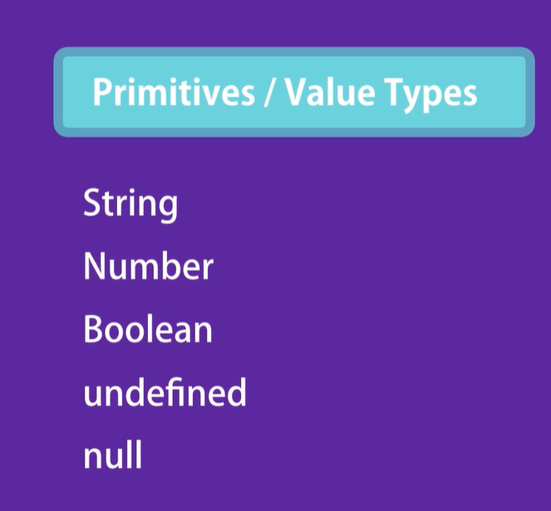

Slide 17
Primitive types code time
primitiveTypes.js

Slide 18
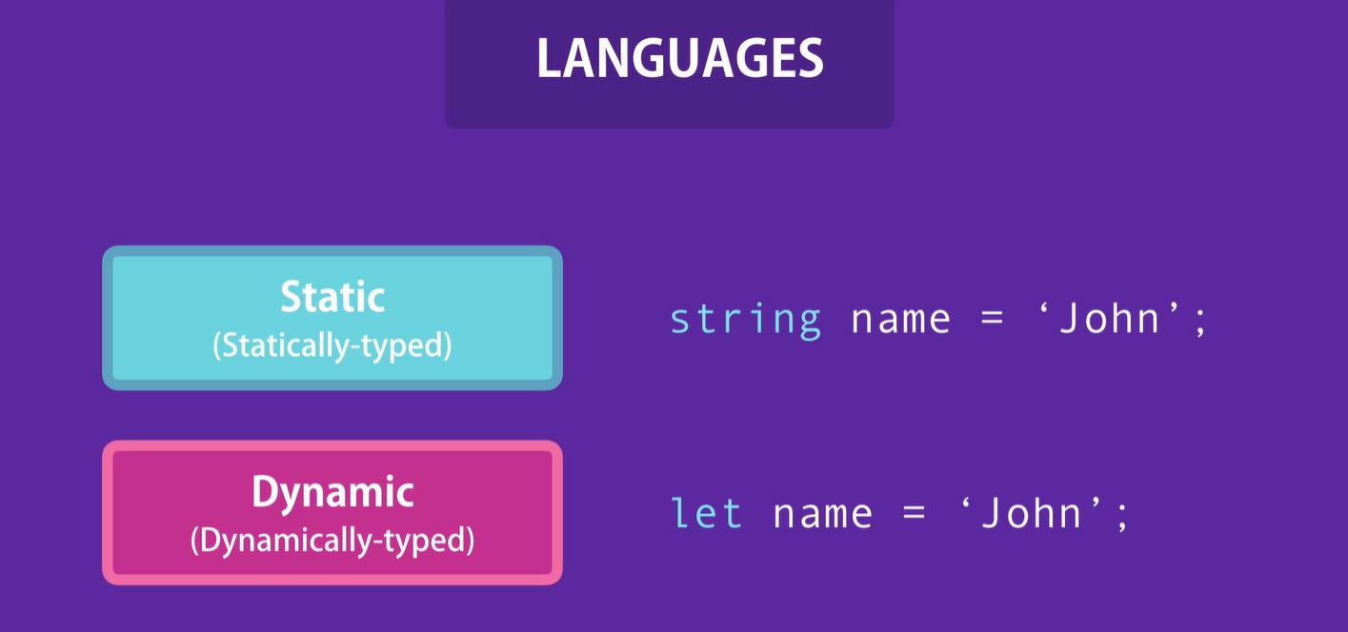
In static languages the type of variable cant be changed.
In Dynamic languages the type of variable can change anytime

Slide 19
Dynamic types code time
dynamicTypes.js

Slide 20
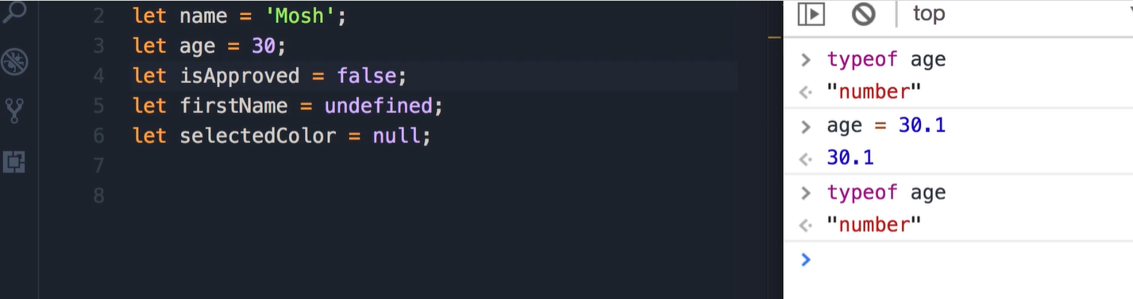
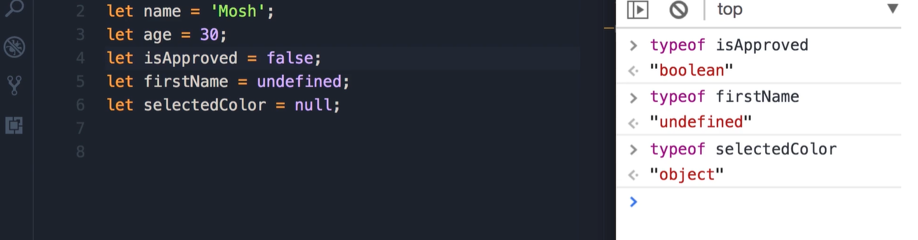

Slide 21
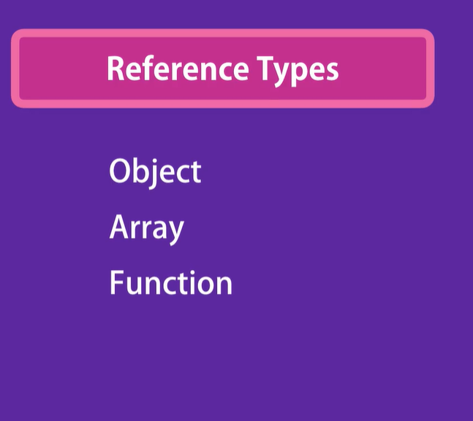

Slide 22

Primitive types code time
What is an Object
primitiveTypes.js

Slide 23
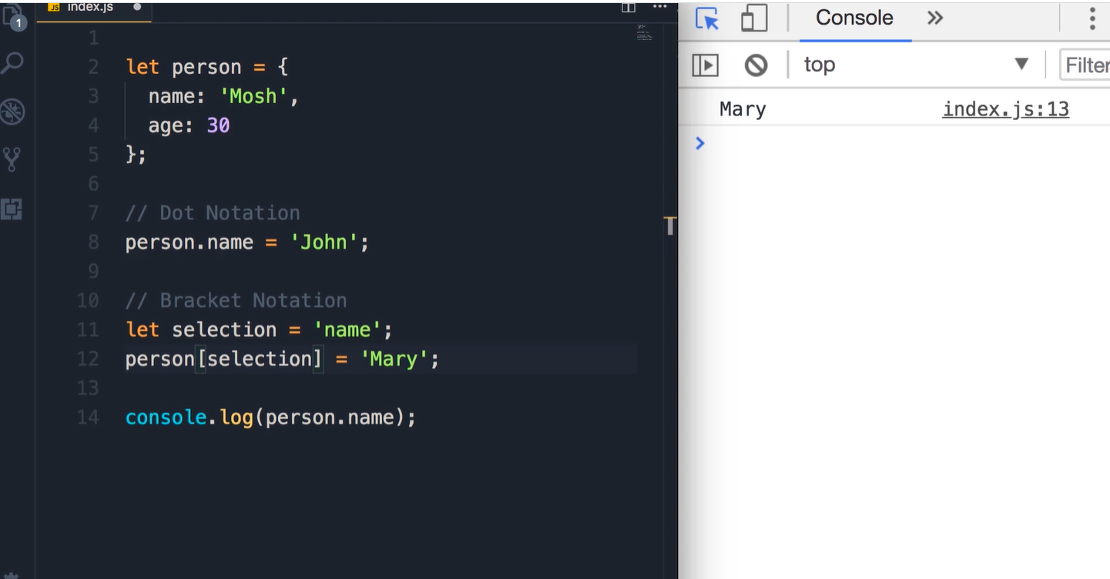
Code example of Object

Slide 24
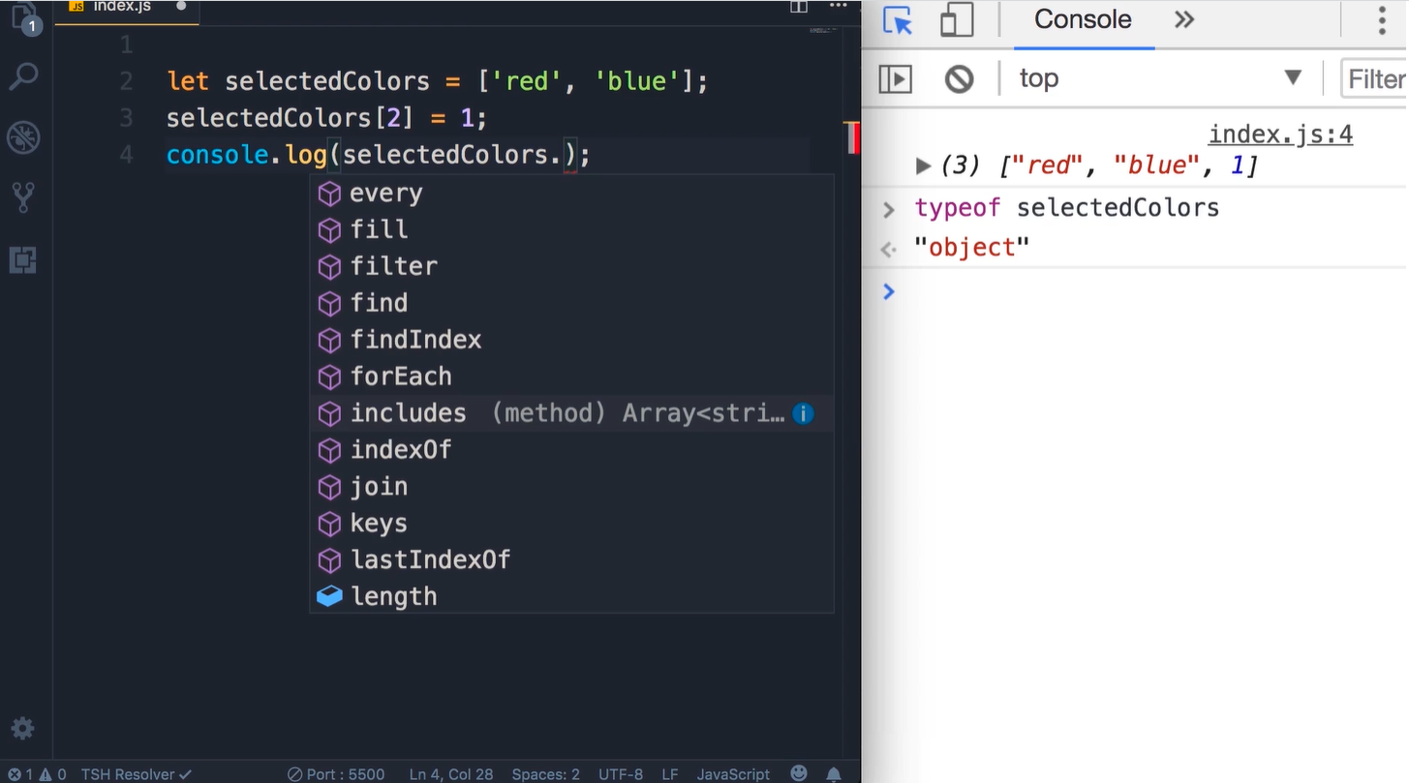
Arrays

Slide 25
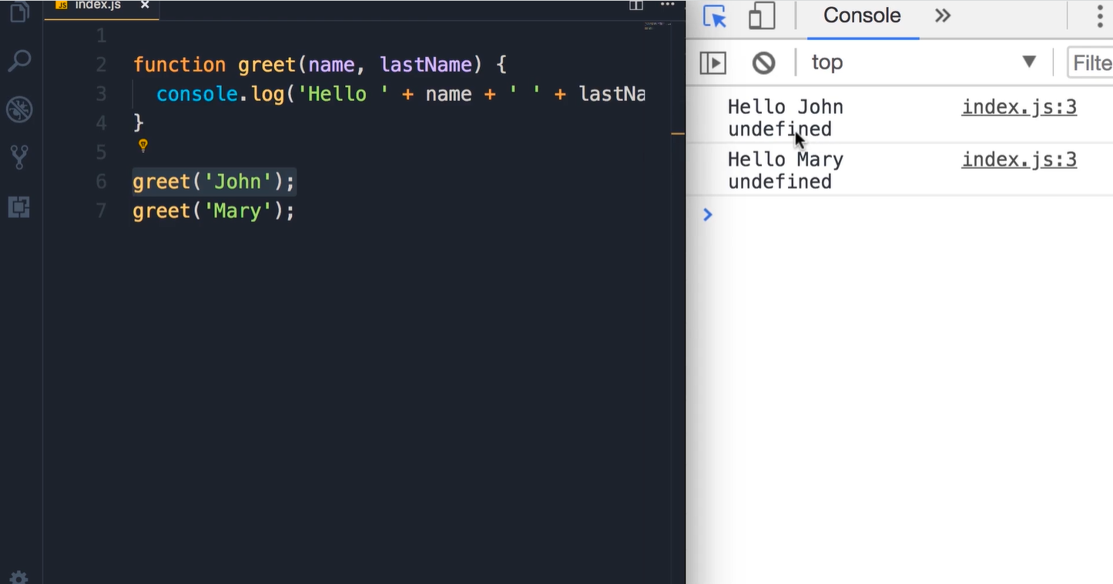
Functions

Slide 26
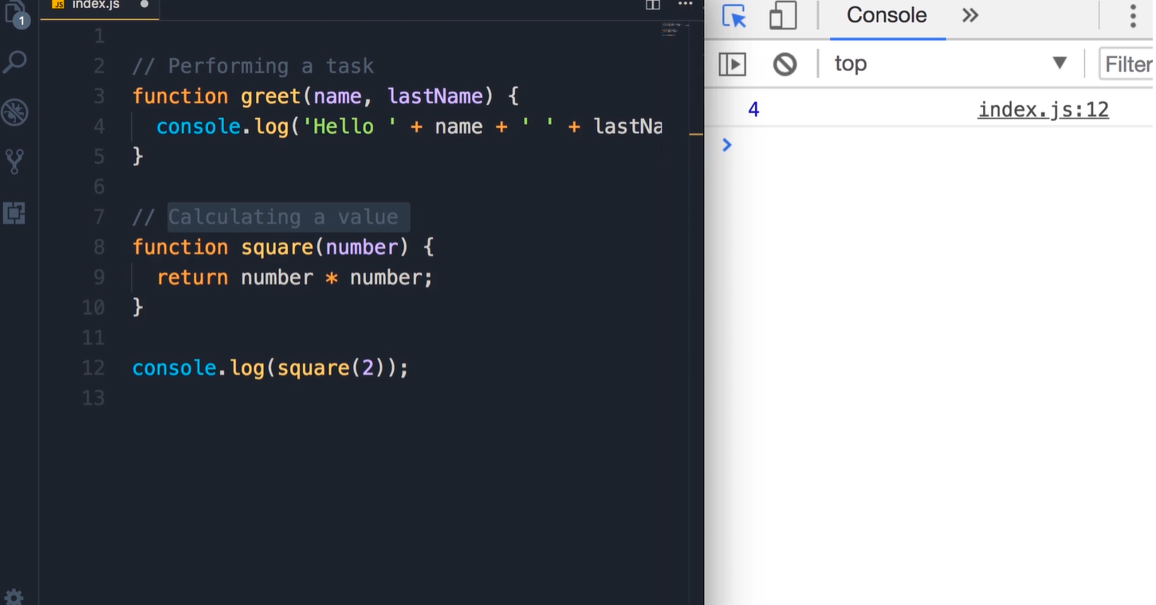
Types of Functions

Slide 27
Control Flow

Slide 28
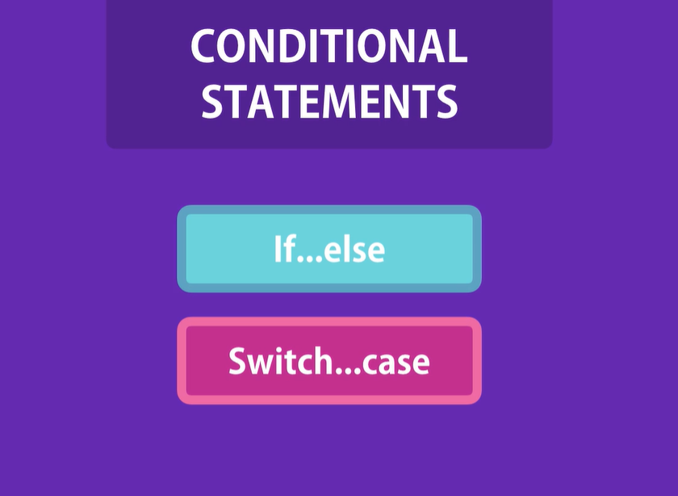

Slide 29
If statement example
// Hour
// If hour is between 6am and 12pm: good morning!
// If it is between 12pm and 6pm: Good afternoon!
// Otherwise Good evening
let hour = 10;
if (hour >= 6 && hour < 12) {
console.log("Good morning!");
} else if ((hour = 12 && hour < 18)) {
console.log("Good afternoon");
} else {
console.log("Good evening");
}

Slide 30
Switch Case
let role = "guest";
switch (role) {
case "guest":
console.log("Guest User");
break;
case "moderator":
console.log("Moderator User");
break;
default:
console.log("Unknown User");
break;
}

Slide 31
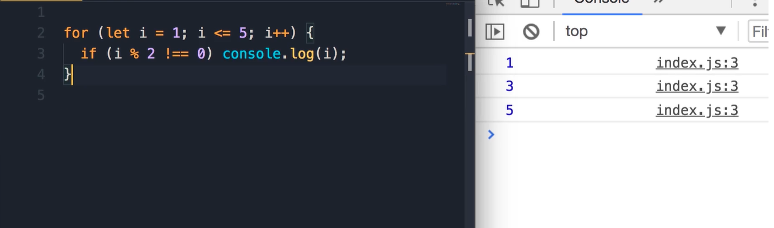
For loop

Slide 32
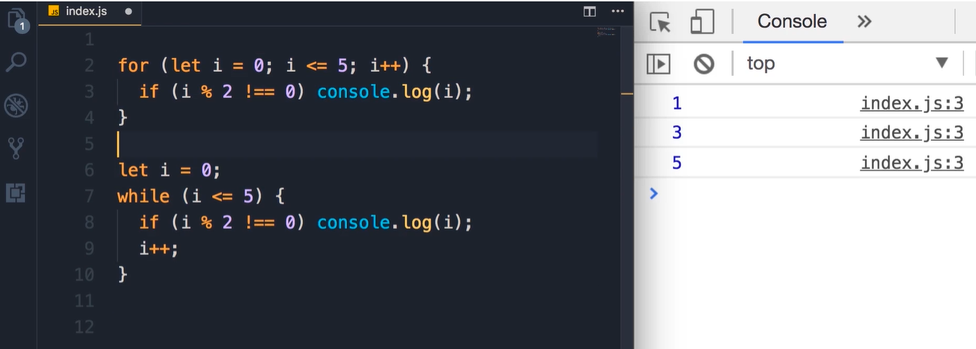
While loop

Slide 33
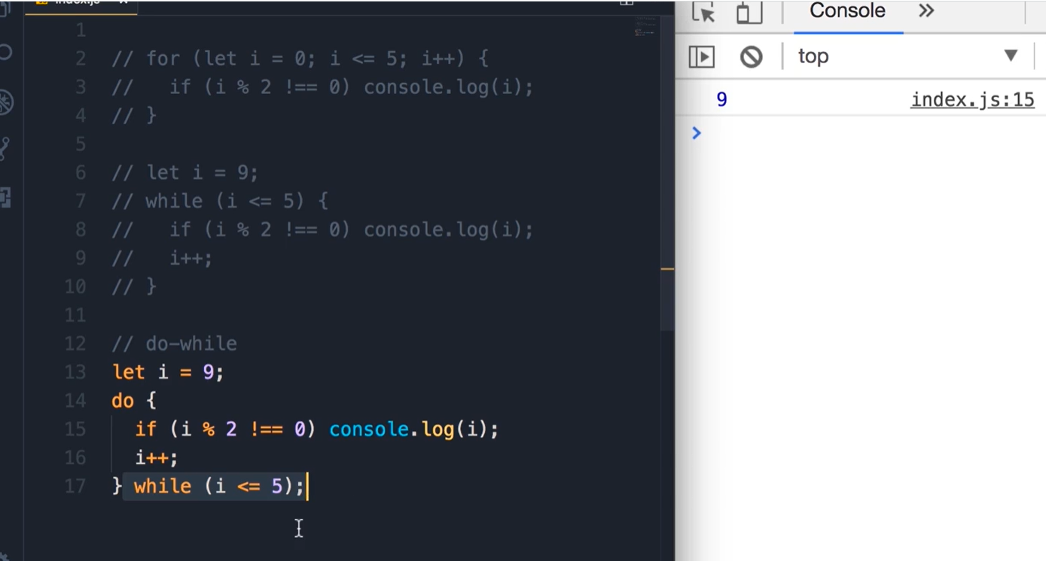
Do While

Slide 34
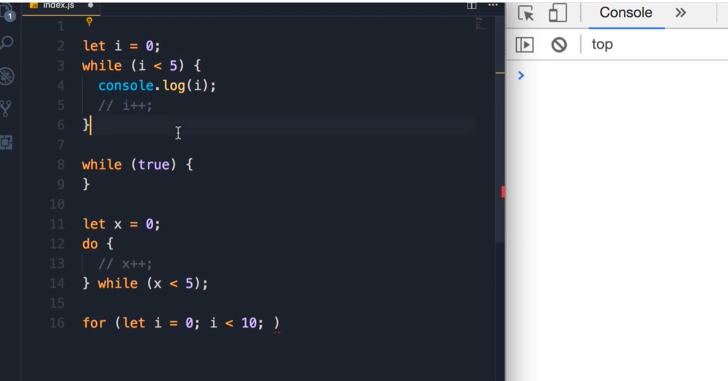
Infinite Loops

Slide 35
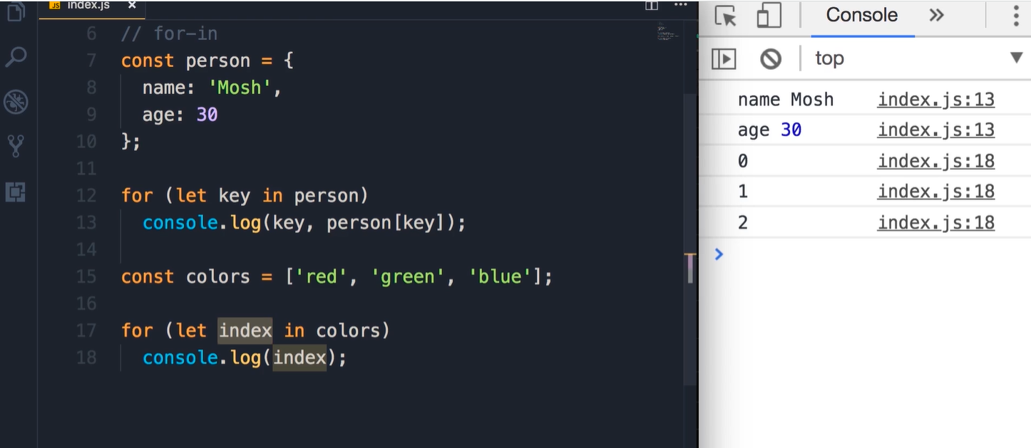
For in

Slide 36
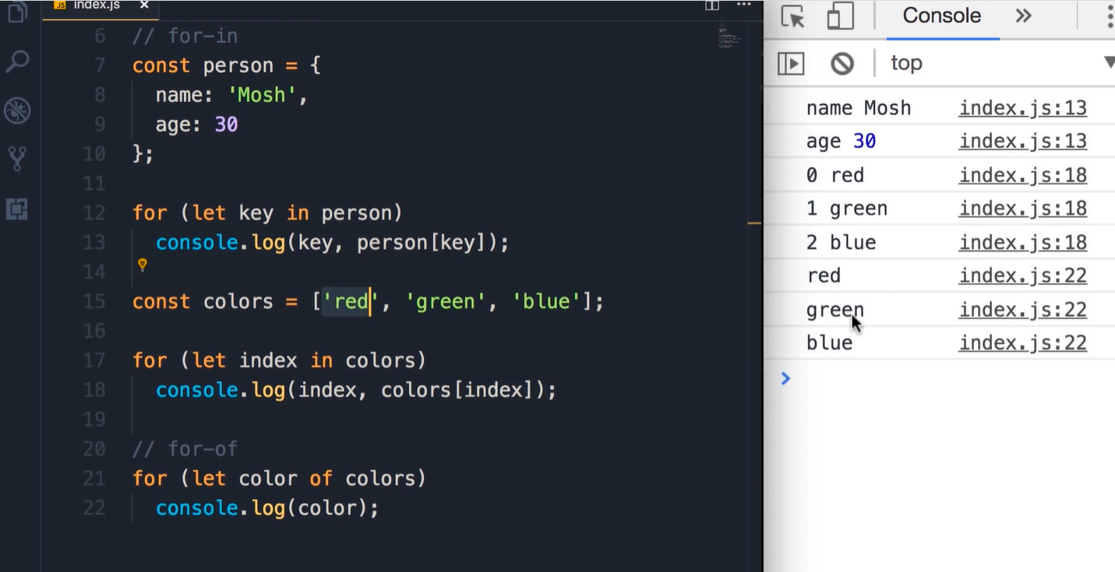
For of

Slide 37
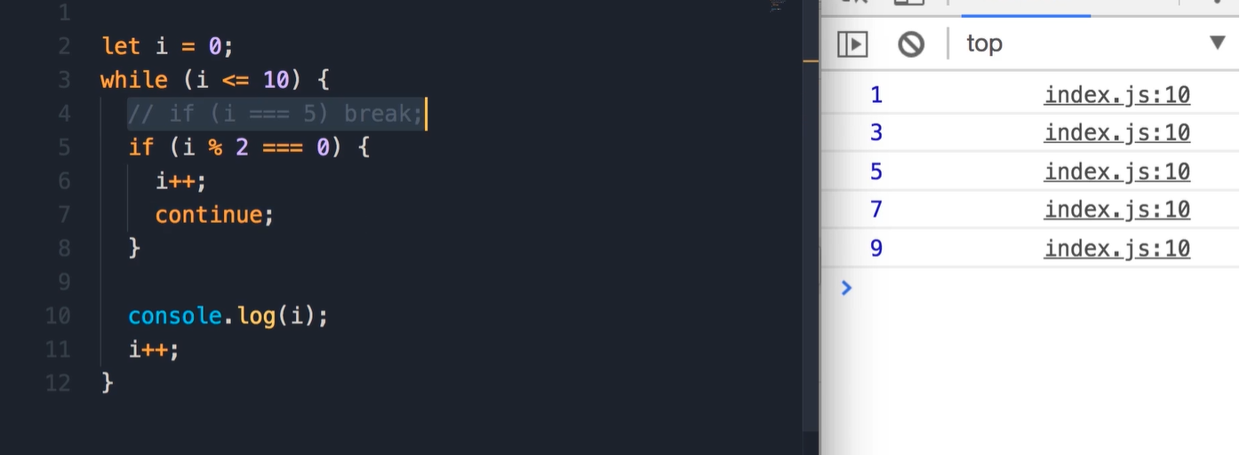
Break and Continue

Slide 38
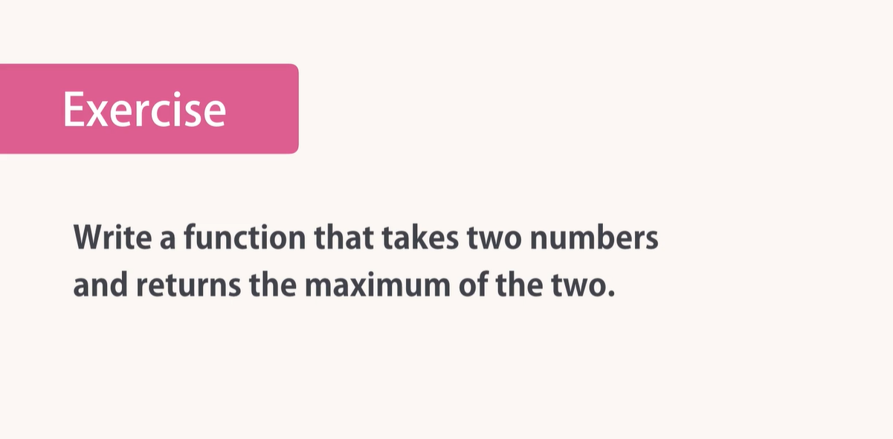

Slide 39
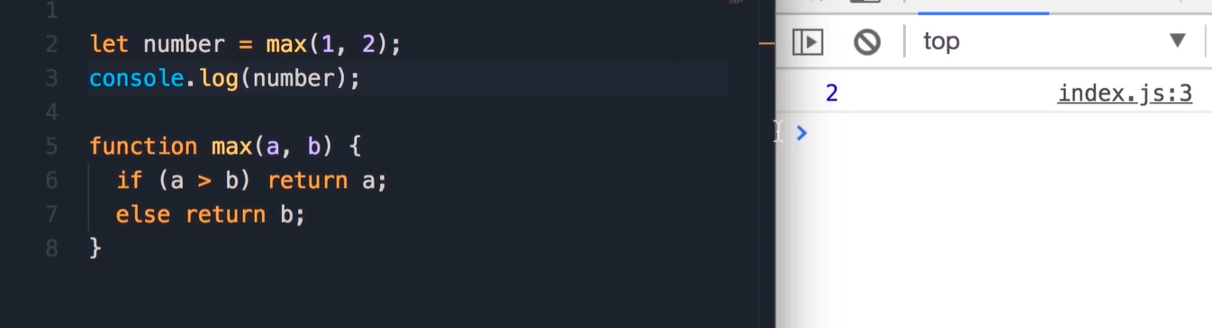
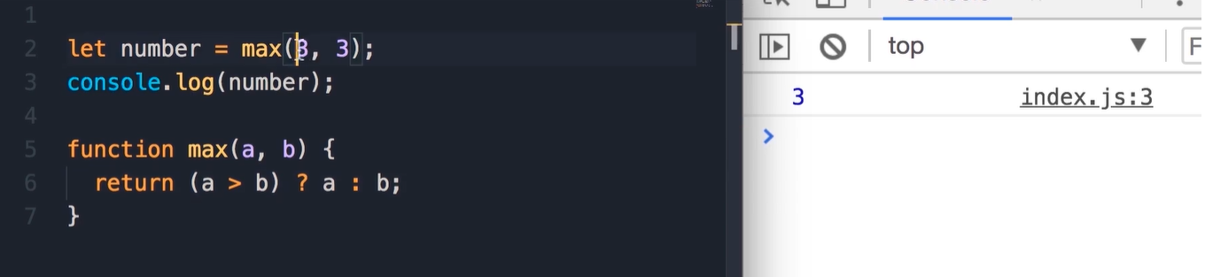
Solution

Slide 40
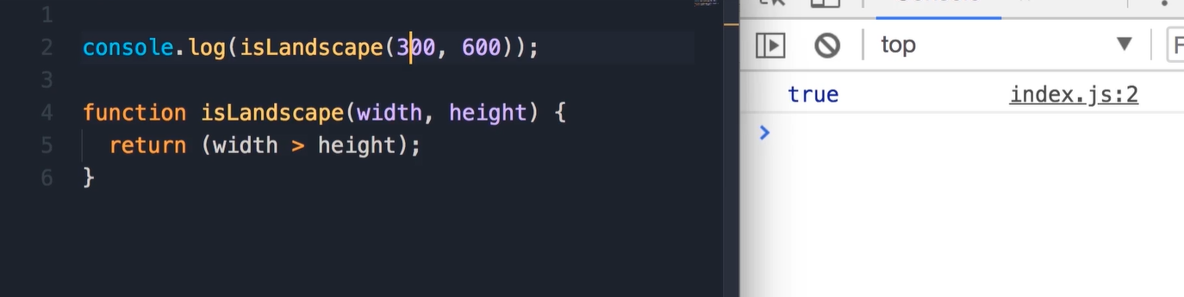
Implement this function

Slide 41
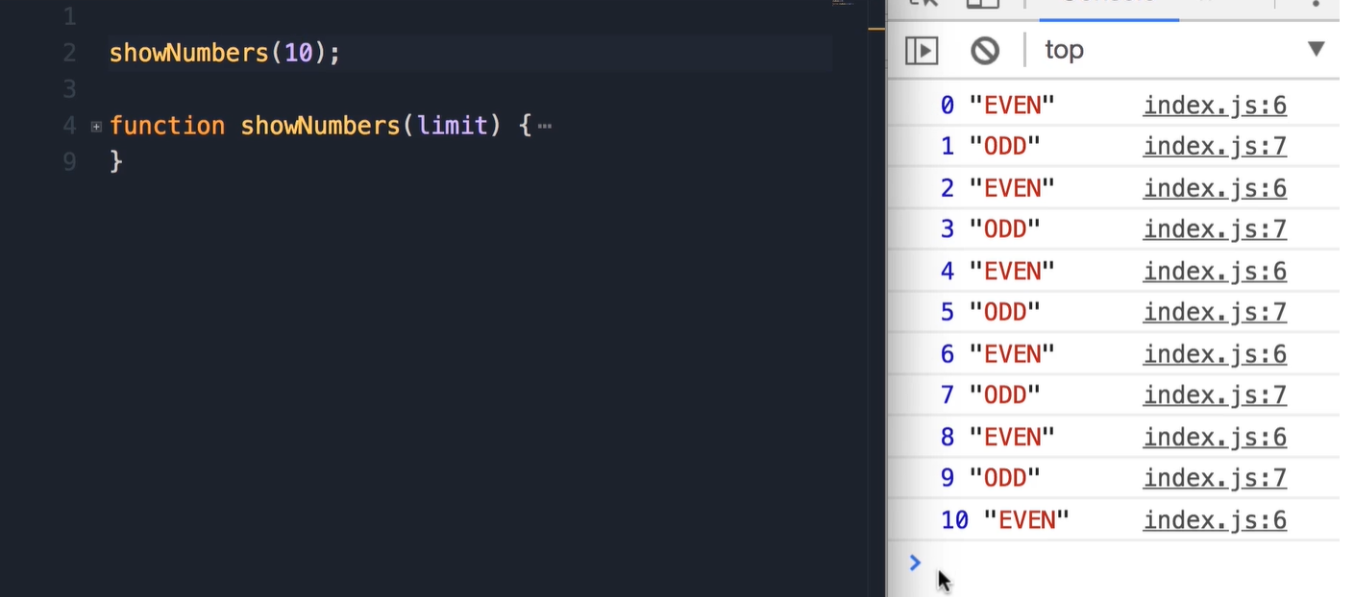
Write this function implementation

Slide 42
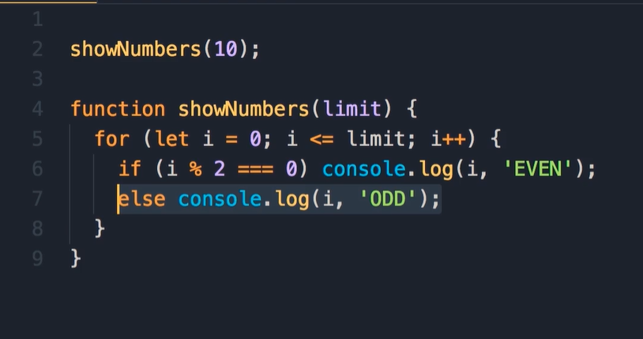
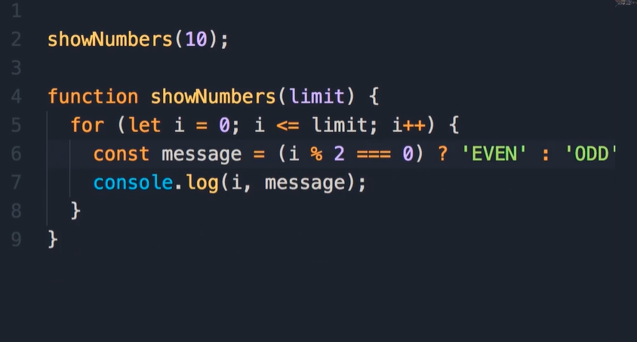
Solution

Slide 43
Objects

Slide 44
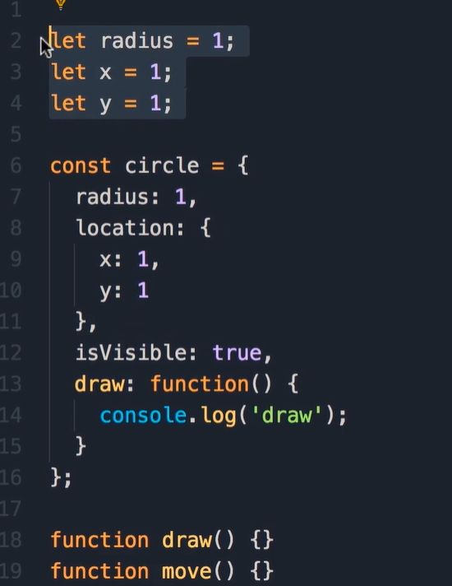
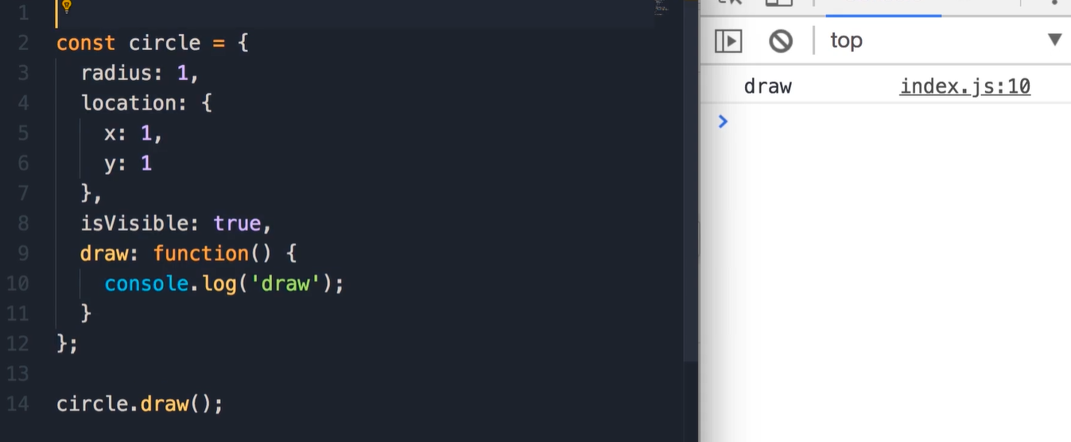
Object Example (OOP)
When u have some related variables, u need to think objects.
Define object using let, const.
Object oriented programing is style of programming where we see a program as a collection of objects that talk to each other to perfume some functionality.
When function is part of object, we called this function as method.

Slide 45
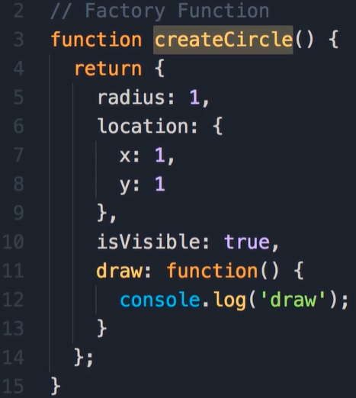
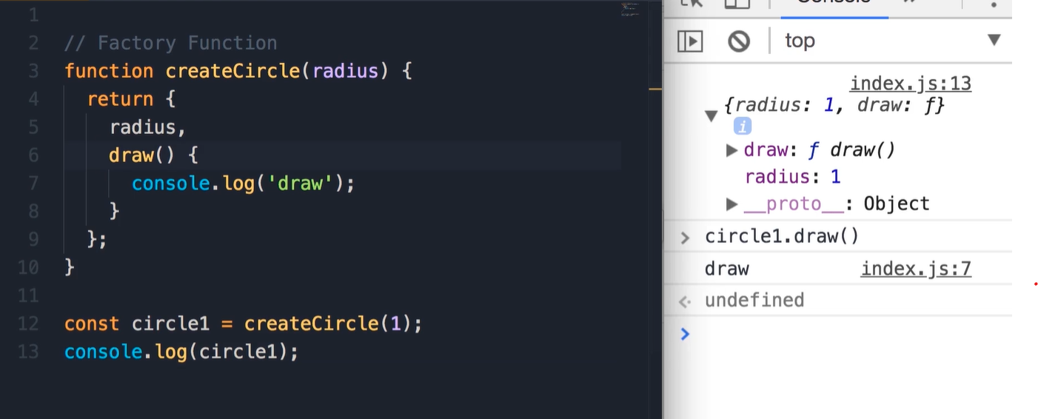
Factory Functions

Slide 46
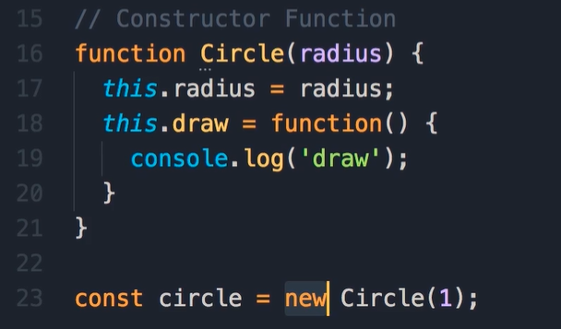
Constructor Function
When we use the new operator:
We create an empty object const
We init the object
The function will return the object

Slide 47
Factory Function vs Constructor Functions
The same good
The constructure pattern is more familiar to those developer that come from C# and Java

Slide 48
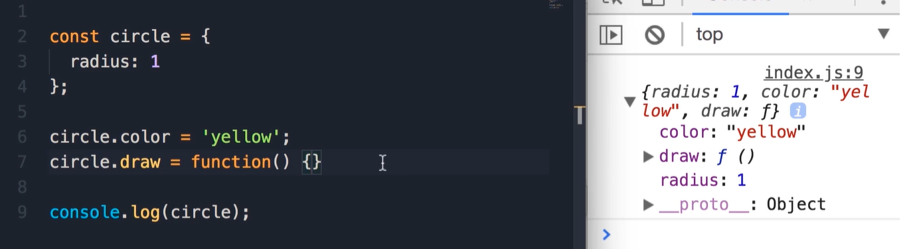
Dynamic Nature of Objects
We can add properties and method dynamically.

Slide 49
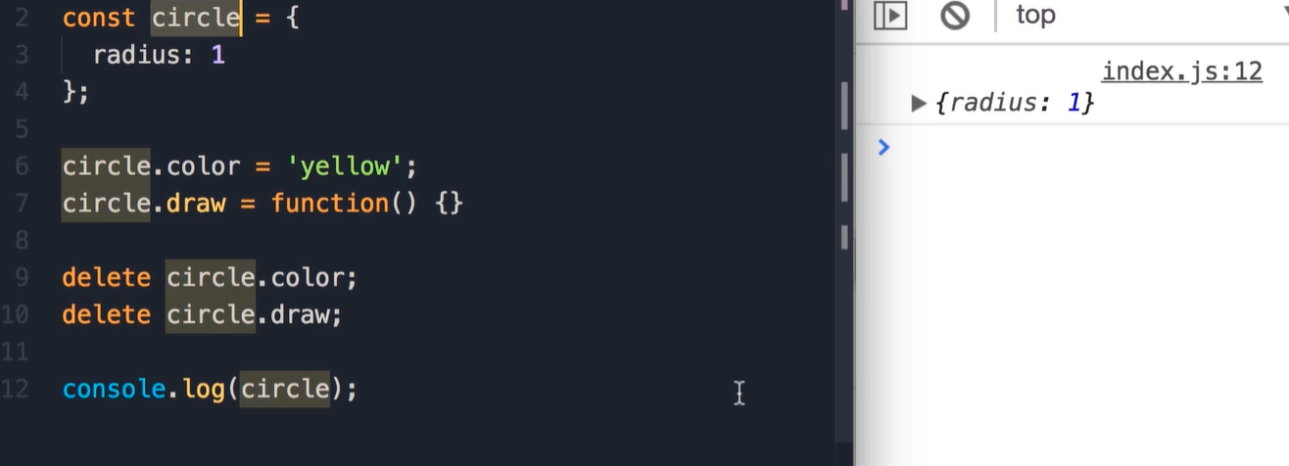
Dynamic Nature of Objects
We can also delete properties and method dynamically

Slide 50


Functions are Objects
Purple icons are methods
blue icons are properties

Slide 51


Slide 52



Value types vs Reference types

Slide 53


Slide 54


Value types vs reafference types
Value type : as u can see value pass by value
Reference type: object pass by his reference

Slide 55

Enumerating Properties of an Object

Slide 56

Cloning an Object

Slide 57


Cloning an Object better way

Slide 58

Clone an Object more elegant way … (spread operator)
It take all the property and methods of an object and put them into another object

Slide 59

Built in Object
Math (link)
Built in objects

Slide 60



String Object
In JavaScript we have two types of strings
String primitive
String object

Slide 61

Date Object

Slide 62
Exercise 1- Address Object
Create an address object with properties (street, city and zipcode).
Then create a function showAddress(address) – take an address and object and displays all the properties of this object

Slide 63

Solution

Slide 64
Exercise 2- Factory and Constructor Functions
Initialize the address object using Factory function
Initialize the address object using the construction function

Slide 65

Solution

Slide 66

Exercise 3- Object Equality
In this exercise we going to use the constructor function that we already have from exercise before in order
To create two address objects. Please create two functions:
areEqual – check if the two objects are equal (remember object are reference types) return true/false
areSame – if address one and address two reference to the same object (if they are the same)

Slide 67


Solution

Slide 68
Exercice 4- Blog Post Object
Create post object with the flowing properties: title, body, author, views, comments as array of (author, body),isLive

Slide 69

Solution

